Slide 1


ITC6008A1 - SEARCH ENGINES AND WEB MINING
Final Project
Panagiotis Goranitis
Nikos Georgantas
Vaggelis Matsoukas
13/12/2021

Slide 2
Project Overview
Main Goals
Create an information retrieval system, based on real data from Stack Overflow
5475 Questions scraped from Stack Overflow webpage out of which 3124 remained after preprocessing
2351 Questions were duplicates
The data were stored in a json file which was used to create the corpus
Two different methods used for information retrieval : Vector Space Model, BERT

Slide 3
Preprocessing Text
Firstly, the files are stripped from non words like code and links.
Then, with the usage of the NLTK python library, a collection of stopwords is imported and text files get cleaned from them. As a result, the bag of words is created.
The next step, is about stemming the words in the vocabulary. In order to do that the NLTK library was used again and especially its attribute PorterStemmer.
As a result of this process, a final vocabulary is created that contains the ‘important’ words reduced in their root.

Slide 4
Vector Space Model
As our main methodology for the Information Retrieval System, we used the Vector Space Model.
After preprocessing the Corpus in order to remove any stop-words and non-words and tokenize each document
TF-IDF was calculated for every document
The same approach was followed for the query as well
The Query-Vector was compared to the Document-Vectors by using Cosine Similarity and the results were sorted out
Only the result that are above average are presented to the user

Slide 5
Auto Correct
The Damerau-Levenshtein distance method was used to create an autocorrect algorithm for the user Queries
A Set of all the unique words in the corpus in addition to all the words in the English vocabulary was created, a total of 245.638 words.
For each word in the query the algorithm calculates the edit distance with the words in the set and returns to the user only the minimum distance match
If the matches are more than one, then the user has the option to choose from a list of recommended words
In order to make the algorithm time efficient. Only the words that start with the same letter as the query word and have similar length (-1,+1) are examined

Slide 6
Query Expansion
The main goal is to expand the query so that it gives extra documents that are closely related to the query, in order to improve its effectiveness
To achieve this, we trained from scratch a word2vec model the total vocabulary of out documents
We used k=5 positions away from each center word
We also trained the model again with phrases(bigrams), in order to create a function that proposes alternate queries

Slide 7
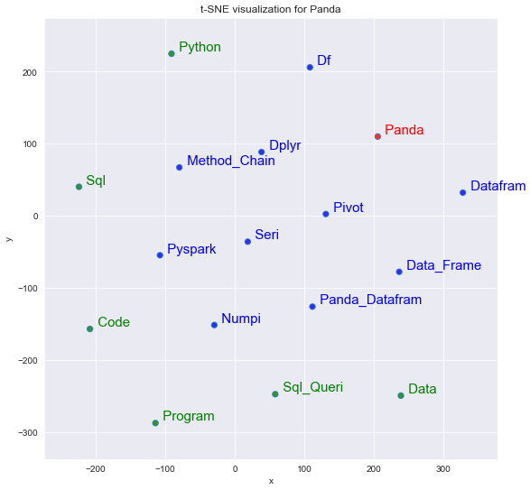
Query Expansion This is a plot showing, with blue, words related to Pandas and green, some other words from our dataset

Slide 8
Clustering
In order to improve the effectiveness of the model, we did try to cluster our unlabeled data.
First, dimension reduction was applied to the original document vectors. At the beginning, vectors had 12960 dimensions.
Vectors were very sparse, so the Singular Value Decomposition method was used to reduce the dimensionality. After SVD was applied, new vectors were of 100 dimensions.
Then, the K-Means method was used to cluster the unlabeled data.
In order to decide the optimal number of clusters two methods were used.

Slide 9
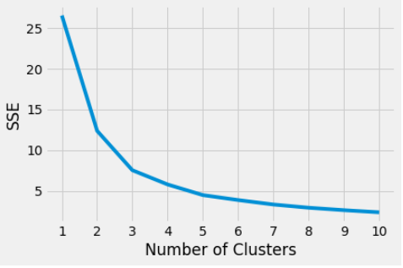
Clustering
Here is a plot between the sum of squared estimate of errors (SSE) with the possible numbers of clusters.
The lower the SSE, the better the cohesion of the clusters created.

Slide 10
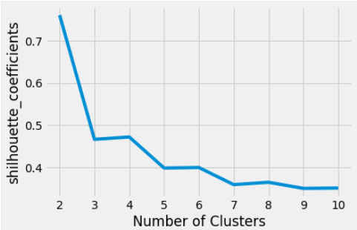
Clustering
This is a plot between the silhouette coefficient with the possible number of clusters.
Silhouette coefficient is a metric with values from 1 to -1 that calculate the goodness of the clustering technique.

Slide 11
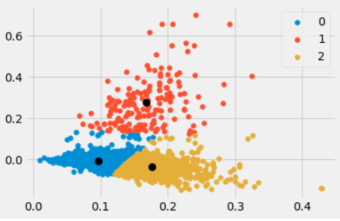
Clustering
Ba
Ba
Based on those two diagrams, three seems to be the optimal number of clusters to create.
In order to ensure that the number of clusters is the best one , also a python library called kneed and especially its attribute KneedLocator was used. The result was the same.
Then the clusters are created and the 2-D visualization is the following:

Slide 12
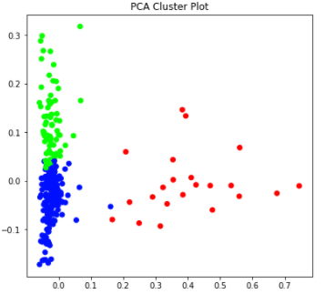
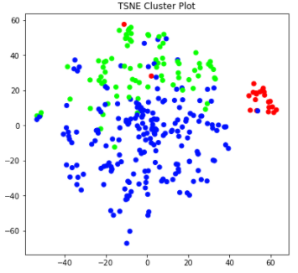
Clustering
The following diagrams were created based on PCA and TSNE method:

Slide 13
Clustering
In the 3 clusters created before, some ‘key’ words were produced. For example, in cluster 0 the words produced are : overflow, update, editing, post, want, hours, improve, ago, question, closed.
In cluster 1 the ‘key’ words are: function, use, object, like, column, value, list, array, table, data.
These words seem to have some cohesion.

Slide 14
Precisio- Recall-F1
In order to measure the accuracy of the Vector Space Model Results. Precision, Recall and F1 were calculated for specific queries.
Example Query: “alternatives for reading sql tables”
Precision: 0.53, Recall: 1 and F1: 0.69
If any of the words in the query were included in the results were labelled as 1 otherwise were labelled as 2
The same approach was followed for the whole corpus but with only a subset of the most important words in the query. For the example above “sql”, “tables”
TP: Query = Corpus = 1
FP: Query = 1, Corpus = 2
FN: Query = 2, Corpus = 1

Slide 15
BERT
Query example used: “Python labelling new data points in a histogram”
Top 3 Result titles:
“How do I traverse implicit code in RecursiveASTVisitor”
“How to resolve invalid package name error in npm”
“Angular Webpack can be used to load scripts dynamically”
As an alternative to Vector Space Model, BERT model was also used.
Due to the context of the corpus as most questions referred to Computer Science topics BERT was unable to provide accurate results

Slide 16
Thank You !

